Slide 1
Car Sales Attributes
A Project Report on
Presented By
Rithwick Negi
Roll no. 18csu173
Under the supervision Of
Meghna Luthra
(The North Cap University)

Slide 2
METHODOLOGY USED
DATA:-
car sales information
Tools Used:-
Anaconda (Jupyter Notebook)
Modules Used:-
Numpy
Seaborn
Pandas
Sklearn
Method Of Analysis
-regression
-classification

Slide 3
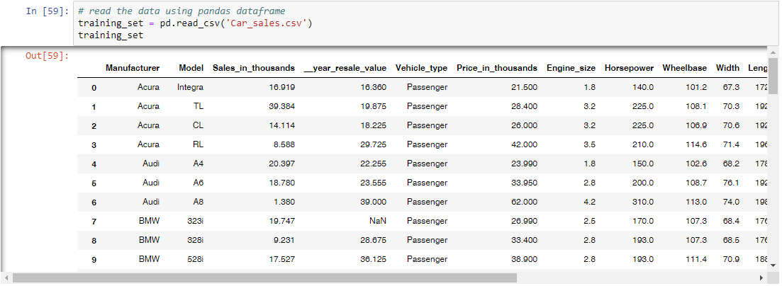
About Data Set
157 rows × 16 columns

Slide 4
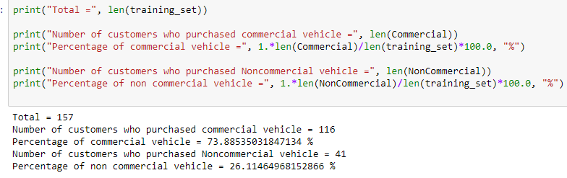
This shows the no. of people who purchased commercial and non-commercial vehicles and their percentage
Analysis Of Data Set

Slide 5
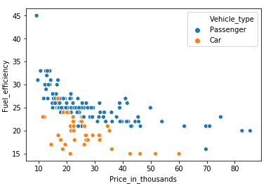
EDA
This is a scatter plot graph of vehicle type between fuel efficiency and price in thousand.

Slide 6
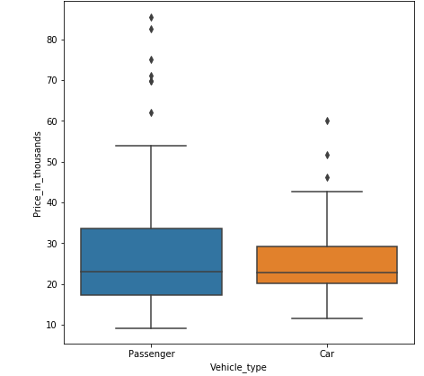
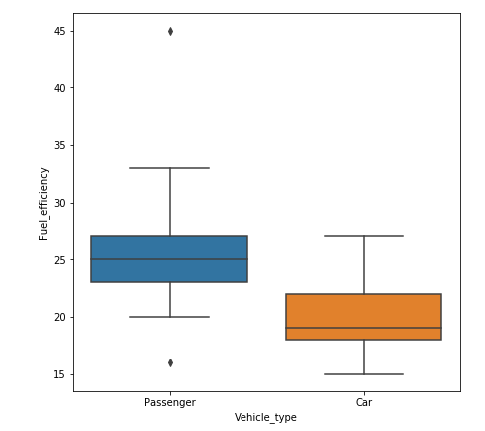
BOX PLOT GRAPH
EDA Cont.
BOX PLOT GRAPH

Slide 7
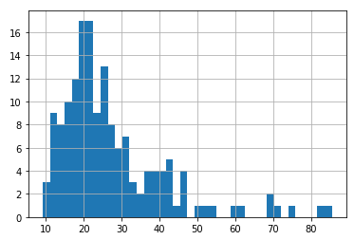
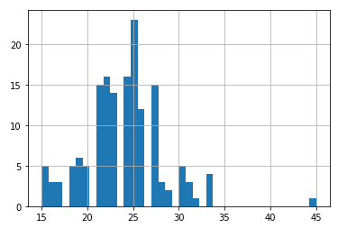
EDA Cont.
Histogram
Price in thousand
Fuel Efficiency

Slide 8
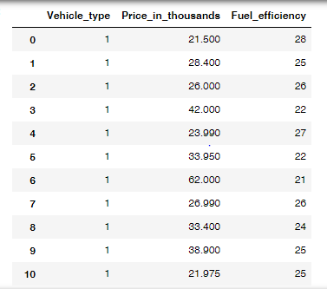
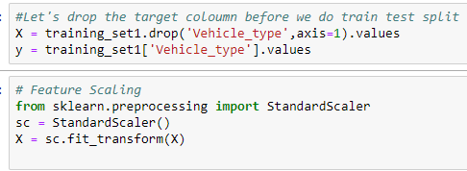
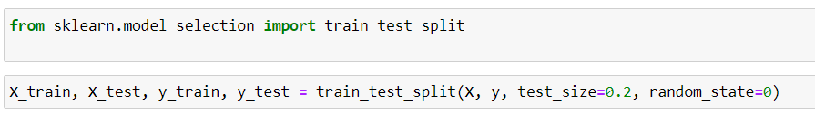
Feature Scaling and split to Training & Testing

Slide 9
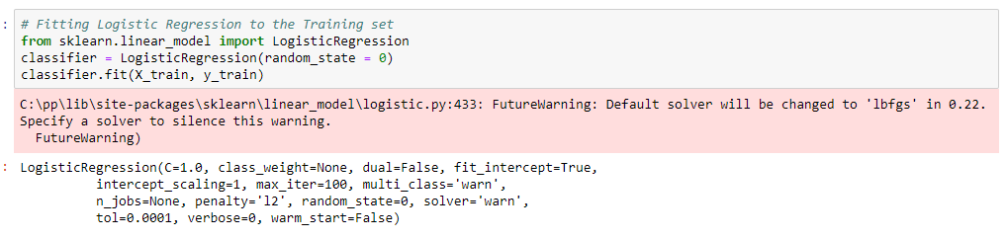
Logistic Regression
Logistic regression is the appropriate regression analysis to conduct when the dependent variable is dichotomous (binary). Logistic regression is used to describe data and to explain the relationship between one dependent binary variable and one or more nominal, ordinal, interval or ratio-level independent variables

Slide 10
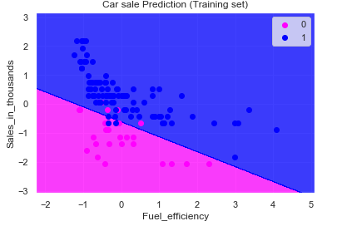
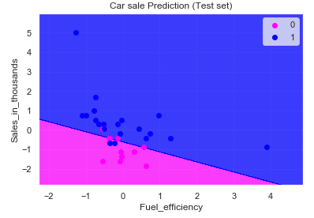
Visualizing the training and testing set results
Listed Colour Map of Training and Test set

Slide 11
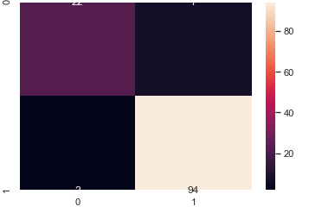
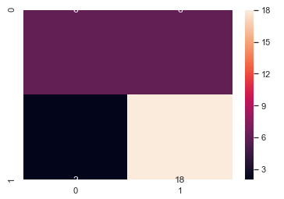
Performance measure and report
Training Set
Test set

Slide 12
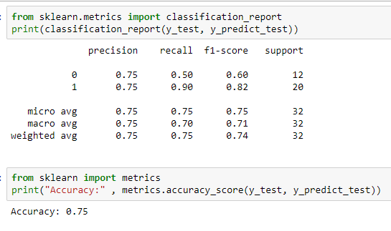
Performance measure and report
Accuracy of logistic regression is 75%

Slide 13
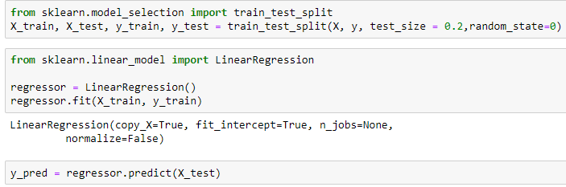
Linear Regression
Linear regression is a common Statistical Data Analysis technique. It is used to determine the extent to which there is a linear relationship between a dependent variable and one or more independent variables.

Slide 14
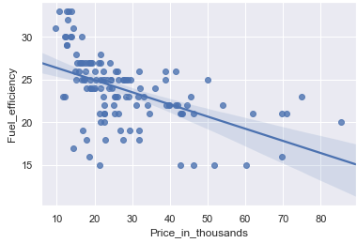
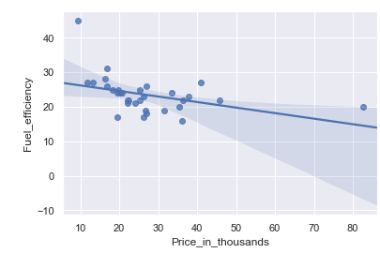

Visualization for Training and Testing Data

Slide 15
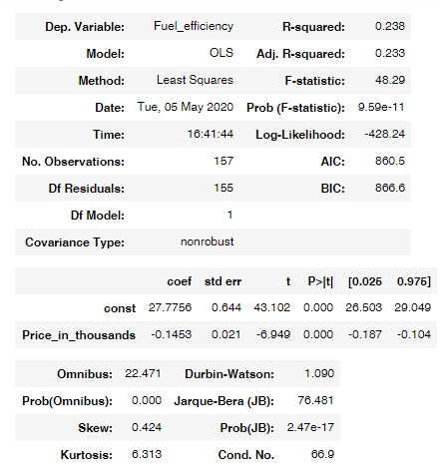


Performance Measures

Slide 16
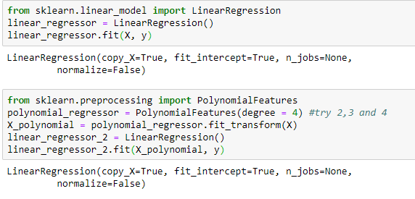
Polynomial Regression
Polynomial Regression is a form of linear regression in which the relationship between the independent variable x and dependent variable y is modeled as an nth degree polynomial.

Slide 17
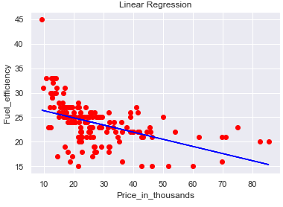
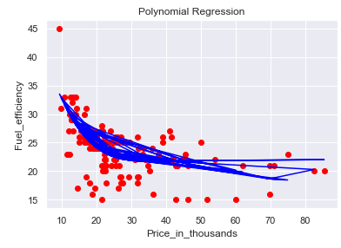
Polynomial Regression
Depending on what the data looks like, we can do a polynomial regression on the data to fit a polynomial equation to it.
Hence If we try to use a simple linear regression in the above graph then the linear regression line won’t fit very well. It is very difficult to fit a linear regression line in the above graph with a low value of error. Hence we can try to use the polynomial regression to fit a polynomial line

Slide 18

Performance Measures
The accuracy after applying polynomial regression is 42.88%

Slide 19
CLASSIFICATION
Classification in machine learning and statistics is a supervised learning approach in which the computer program learns from the data given to it and makes new observations or classifications.
Here we will apply 3 classification models to our dataset namely decision tree, Naive Bayes and KNN.

Slide 20

Decision Tree
Decision Tree is a simple representation for classifying examples. It is a Supervised Machine Learning where the data is continuously split according to a certain parameter.

Slide 21

Decision Tree
X: Fuel Efficiency, Sales in Thousand
y: Vehicle Type

Slide 22
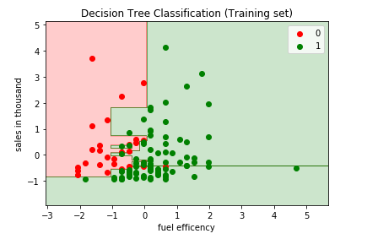
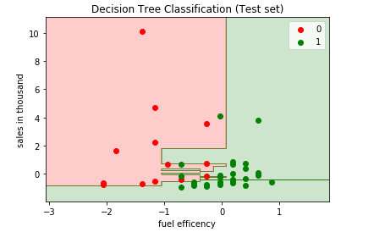
Visualizing Training and Testing data

Slide 23
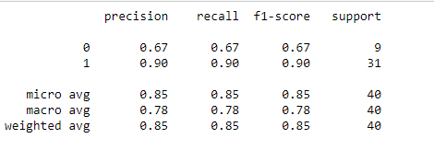
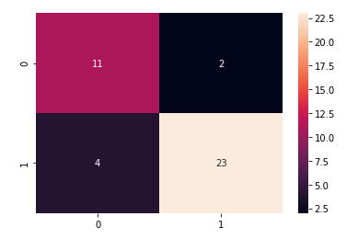

Performance Measures
F1 Score with Precision and Recall
CONFUSION MATRIX
ACCURACY: 85%

Slide 24

Naive Bayes
It is a classification technique based on Bayes’ Theorem with an assumption of independence among predictors. In simple terms, a Naive Bayes classifier assumes that the presence of a particular feature in a class is unrelated to the presence of any other feature.

Slide 25
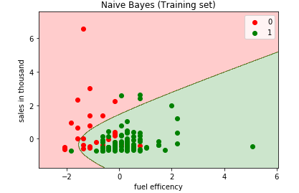
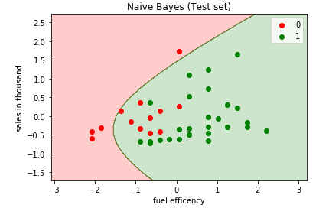
Visualizing training and testing data

Slide 26
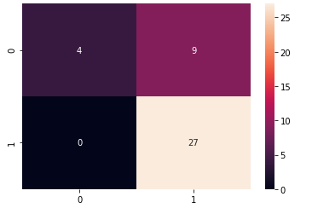

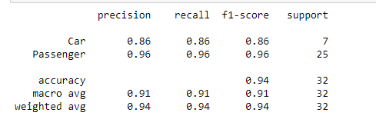
Performance Measures
CONFUSION MATRIX
Mean Accuracy
F1 Score with Precision and Recall

Slide 27
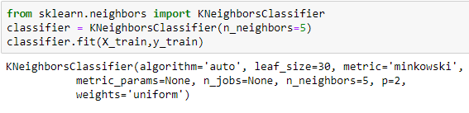
KNN
A K-nearest-neighbor algorithm, often abbreviated k-nn, is an approach to data classification that estimates how likely a data point is to be a member of one group or the other depending on what group the data points nearest to it are in.

Slide 28
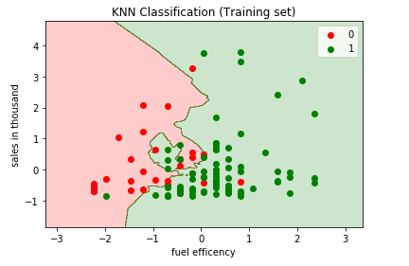
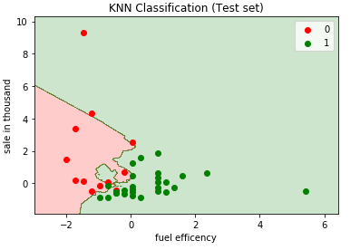
Visualizing training and testing data

Slide 29
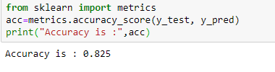
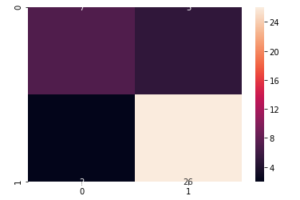
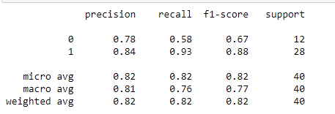
Performance Measures
ACCURACY: 82.5%
CONFUSION MATRIX
F1 Score with Precision and Recall

Slide 30
Analysis of classification models
The accuracy for Decision Tree is 85%.
The accuracy for Naive Bayes is 87.7%.
The accuracy for KNN is 82.5%.
So according to this Naive Bayes is the best classification model for our dataset.

Slide 31
Thank You

